Slide 1
Development and implementation of the RCM Research and Development Strategy
Dr Jude Field and Jenny Cunningham, Research Advisors

Slide 2
Developing the strategy
The strategy was developed with the involvement of UK midwifery research and clinical leaders, research active midwives and RCM members.
“In order for women and their babies to receive high quality care, practice needs to be underpinned by evidence and provided by midwives who think critically about the care that they provide.”
Collaborating with others
Influencing
Building capacity

Slide 3
Our vision
Promoting midwifery research and evidence-based practice to develop the professional standing of midwifery, the quality of maternity services and professional standards.
Supporting our members, individually and collectively, to build a stronger research and knowledge base, developed by and relevant to midwifery practice.
Influencing systems and practice to embed research across the midwifery profession, including in clinical settings, and to develop improved career pathways for midwives in research.

Slide 4
Implementing the strategy
Research Hub
Annual education and research conference
Maternity research map
Doctoral thesis collection
Peer-to-peer support buddy scheme
RCM Small Research Awards
Bespoke midwifery focused e-learning modules
Research prioritisation project
Research Hub (rcm.org.uk)

Slide 5
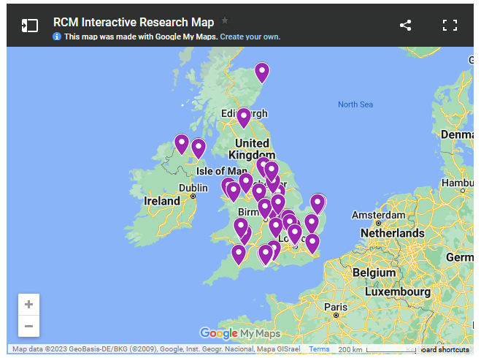
Maternity research map
We aim to support the development of a community of midwives and other health care professionals who wish to work together on maternity research
International
Multi-professional
Any discipline
Notes:
So far we have:
Midwives
Obstetricians
Anaesthetists
Social scientists
Nutritionists
Professors of midwifery
Other Professors
Health researchers/ academics

Slide 6
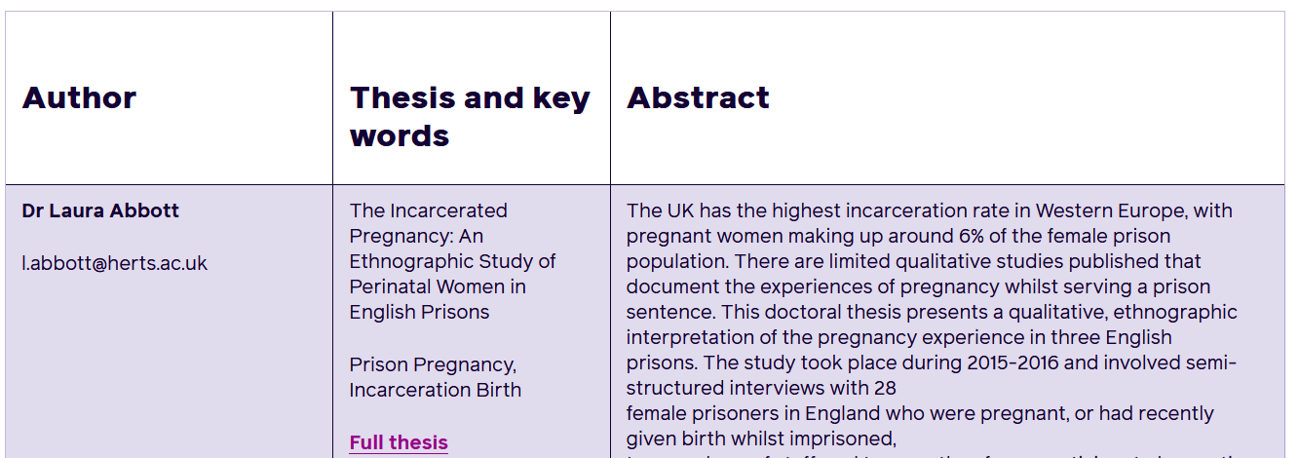
Doctoral thesis collection
Our aims:
Showcasing midwives' academic work
Open access midwifery generated research
International
Inspiring others

Slide 7
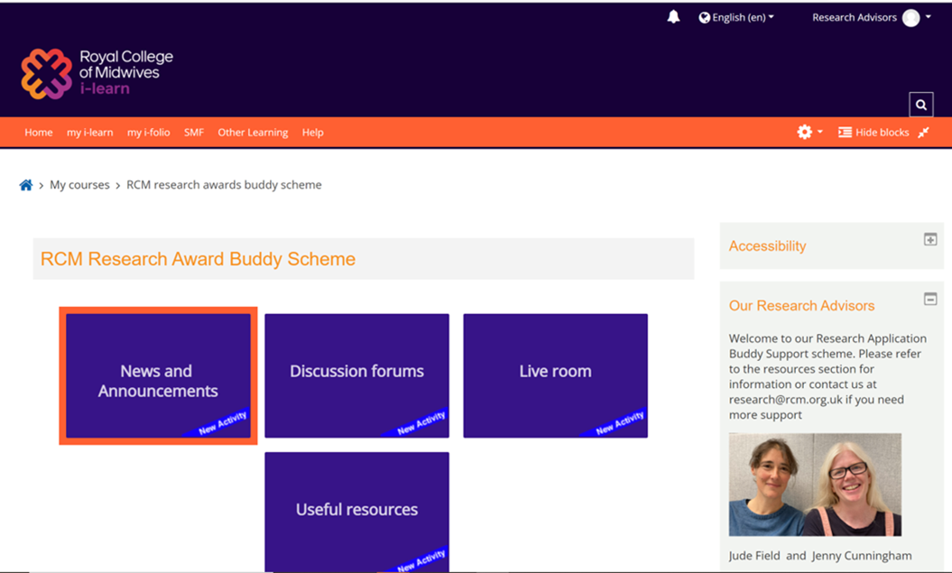
Buddy scheme
Jointly funded research award for UK based RCM midwife members
Collaboration with past award winners
Self-directing applicant/buddy dyads to support the application process

Slide 8
Small Research Awards 2023
We are creating opportunities for RCM members to undertake a research-based activity that could be of benefit to them later in their career:
making connections with midwives who already work in research
deepening their research knowledge in a particular area of midwifery practice
developing a brief research proposal that could then be developed further in the future

Slide 9
Three research e-learning modules
Professional development
Resource for RCM members
Collaboration with a UK university
Stakeholder involvement
Hosted on RCM e-learning platform

Slide 10
Research prioritisation project – ‘top 10’
Working with midwives and a range of stakeholders
All midwifery practice environments included
Aim to highlight the voice of midwives and service users to influence maternity funding agenda in UK
A delphi style consensus building project with the James Lind Alliance

Slide 11
Thank you for listening
research@rcm.org.uk

